Slide 1

CFSH Psychiatric Residential Treatment Facility J12-9830-SG
Project Objective: To create a Psychiatric Residential Treatment Facility (PRTF) primarily designed to safely and securely house juveniles committed to the Department of Juvenile Justice who have been determined under S.C. Code Ann. Section 63-19-1450 to have a mental illness requiring transfer to the Department of Mental Health for treatment, and whose needs require a period of treatment in a psychiatric residential treatment facility, but whose needs cannot be met in an available private facility.

Slide 2
SC Agencies Joint Effort to Achieve Objective
Four agencies have established a Memorandum of Understanding (MOU) in the bearing of providing proper facilities and treatment services for justice-involved youth requiring mental health treatment (“Youth”).
  South Carolina Department of Health and Human Services (SCDHHS)
  South Carolina Department of Mental Health (SCDMH)
  South Carolina Department of Juvenile Justice (SCDJJ)
  South Carolina Department of Children’s Advocacy (SCDCA)
With combined efforts the agencies utilize their experience treating and serving the target Youth population to ensure requirements are achieved and goals are reached.
SCDMH has been tasked with overseeing the Project to ensure milestones are met timely and completely. With this SCDMH has borne overall responsibility for the completion and success of the Project.

Slide 3
Project Details
Location: SCDMH property in Northeast Columbia, adjacent to the G. Weber Bryan Psychiatric Hospital.
Project Address: 255 Faison Drive, Columbia, SC 29203
The PRTF will be a 1-story building with 24 beds for the residents and shall include a treatment program and all services necessary to provide the required level of care needed for the full-time residential care of youth living in a secure facility.
The services will include:
Treatment
Rehabilitative Services
Pharmacy Services
Nutritional Services
Educational Services
Recreation (indoor and outdoor)
Security
Transportation

Slide 4
Location Map

Slide 5
Overview of Current Site Location
G. Weber Bryan Psychiatric Hospital

Slide 6
Site Plan

Slide 7
Participant Involved
SC Agencies | Agency PM | AHJ & Regulator | GEO & Survey | Inspections & Compliance | DBOM
SCDJJ | LCK | OSE | S&ME Geotechnical Exploration Services | SSOE Peer Review | CCSC Developer
SCDCA |  |  |  |  | Concord Developer PM
 |  |  |  | System WorCx Commissioning
SCDHHS |  | DHEC | Dennis Corporation Existing Condition Survey |  | Nelson A/E
 |  |  |  | S&ME 3rd Party Insp.
SCDMH |  |  |  |  | Balfour Beatty General Contractor

Slide 8
Coordination and Communication
OSE
DHEC
LCK
Agency PM
System WorCx
Commissioning
SCDMH
S&ME
3rd Party Insp.
SCDCA
SSOE
Peer Review
SCDJJ
CCSC
Developer
SCDHHS
Concord
Developer PM
Dennis Existing Survey
Nelson
A/E
S&ME Geo Exp
Balfour Beatty
GC
Notes:
Coordination Tornado
Without guidelines, procedures, contracts, and agreements in place the PRTF project would be like lassoing a tornado.

Slide 9
Overview of the Various Participant Relationship
Office of State Engineer
DHEC
SCDHHS
CCSC
Developer
SCDJJ
SCDMH
LCK
Agency PM
Concord
Developer PM
SCDCA
SSOE
Peer Review
Nelson
A/E
System WorCx
Commissioning
Dennis Existing Survey
S&ME Geo Exp
S&ME
3rd Party Insp.
Balfour Beatty
GC

Slide 10

Office of State Engineer (OSE)
Office of State Engineer (OSE) – The primary role is to assist the Agency in procuring design and construction in the manner best suited to the Agency’s needs. The State Engineer is responsible to assure that all such procurements comply with state law. The State Engineer, as the Building Official and Deputy State Fire Marshal for construction of state buildings and facilities, is responsible to assure all such construction provides a safe environment for all occupants.
OSE Manual, 2023 edition – The SC Consolidation Procurement Code and other Statutory Provisions require OSE to prepare and maintain the Manual for Planning & Executing of State Permanent Improvements. According to Section 11-35-830, all procurements involving construction and construction-related design services, including any pre- and post- procurement activities in this area, must be conducted in accordance with the Manual for Planning and Execution of State Permanent Improvements.
Procurement Services (sc.gov)

Slide 11

Construction Manager Agent Services
LCK Construction Services, LLC
Those professional services associated with contract administration, project management, and other specified services provided in connection with the administration of a project delivery method.
SCDMH has hired LCK Construction Services, LLC per OSE manual Chapter 4 guidelines to provide Project Management Services for the PRTF project. In this role, LCK is the agency’s representative during the design, construction, and project closeout.
Responsibilities include:
Single point of contact to distribute project information and updates.
Tracking and confirming the project stays within the established budget and schedule.
Ensuring OSE and state regulations for construction projects are adhered to.
Assist in reviewing all construction documents for accuracy and compliance.
Construction administration.

Slide 12

GEO & Survey
Dennis Corporation is the firm hired to furnish surveys to describe physical characteristics, legal limitations, and utility locations for the project site.
S&ME is the firm hired to provide geotechnical engineering services for test borings, soil bearing values, evaluation of hazardous materials, seismic evaluation, ground corrosion test and resistivity test, including necessary operations for anticipating subsoil conditions.

Slide 13

Design-Build-Operate-Maintain(DBOM)
Correct Care of South Carolina, LLC
Design-Build-Operate-Maintain (DBOM): A project delivery method in which an Agency enters into a single contract for the design, construction, maintenance, and operation of an infrastructure facility over a contractually defined period.
DBOM was selected as the project delivery method as the most advantageous for the State for this specific project. The DBOM delivery method has been determined to be the most timely, economical, and successful approach for the completion of this particular project based on size, scope, and complexity.
Correct Care of South Carolina, LLC is the firm contracted with for the DBOM.
Design Professional: Architectural and Engineering Firm(s) hired by the DBOM to provide preparation of plans, reports, calculations, models, schematics, drawings, specifications, submittals, the Construction Documents, and additional instruments of service required to be performed or under the responsibility of licensed design professionals.
Notes:
Design Professionals: The Lead A/E of record is Nelson Worldwide. Nelson has partnered with:
Shear Structural for the Structural engineering services.
Thomas & Hutton for the Civil engineering services.
RMF Engineering for the Electrical Mechanical, & Plumbing Services.
BGA for the Security Electronics Services.
Balfour Beatty is the General Contractor.
CCSC has partnered with Concord Healthcare as their project manager to oversee the design team and GC.

Slide 14

Independent Peer Review
SSOE, Inc.
Independent Peer Reviewer services (IPR)
are additional architectural and engineering
services that an agency must acquire in the procurement
of D-B services.
The function of the IPR is to confirm that key elements of
the engineering and architectural design provided by the
DBOM are consistent with the professional skills and care
ordinarily provided by practicing design professionals in the same region under the same circumstances.
SC Code section 11-35-3024(3)(b) and SC Regulation 19-445.2145(A)(7) defines independent peer reviewer services and their use.
The agency has hired SSOE, Inc. to provide IPR per OSE Manual Chapter 4 and Chapter 12.
Construction for the PRTF will not commence until OSE and IPR have reviewed and approved properly completed design documents.

Slide 15

Third-Party Inspections
S&ME, Inc.
Per Chapter 12 section 12.22 of the OSE manual, the Agency must procure inspection and material testing services to provide tests and inspections in accordance with Chapter 1 of each applicable International Code Council (ICC) Services of Codes and with Chapter 17 of the International Building Code.
Firms hired to provide these services are referred to as Third-Party Inspectors.
OSE maintains and enters into statewide contracts for inspection and material testing services firms to ensure the construction of facilities is performed in accordance with building codes and contract documents.
From the statewide contract the Agency has hired S&ME, Inc. to provide the Third-party Inspections.

Slide 16
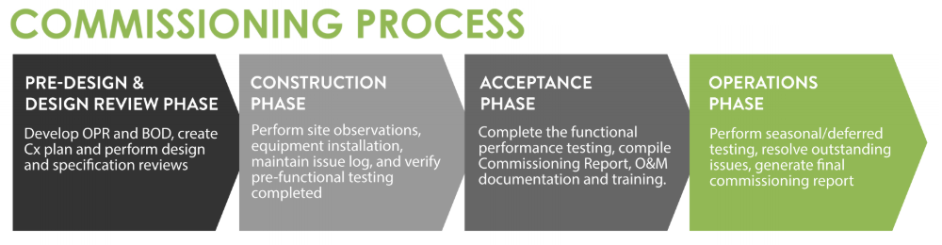
Commissioning System WorCx, LLC
Commissioning the building – A systematic process of ensuring that a building performs in accordance with the design intent, contract documents, and owner’s operational needs.
While similar to some of the requirements outlined for third-party inspections, the Commissioning firm provides additional checks to ensure that the building design is successfully constructed and operated. Unlike third-party inspectors, the commissioning firm is brought on during the design phase to develop a Commissioning Plan, commissioning scope for inclusion in design documents, and review of construction documents. During the construction phase, the Commissioner verifies equipment meets standards and performs per the manufacturer’s claims.
The agency has procured System WorCx, LLC. to provide the Commissioning services through procedures outlined in OSE Manual Chapter 4.
Systems to be commissioned for the PRTF project:
  HVAC System – all equipment, related accessories, and building automation system HVAC controls
  Domestic Hot Water
  Lighting controls
  Smoke Control System

Slide 17

DHEC & DHFC
The infrastructure and program for the PRTF shall be licensed by the SC Department of Health and Environmental Control (DHEC) under Licensing Standards 61-103, Residential Treatment Facilities for Children and Adolescents.
The Division of Health Facilities Construction (DHFC) is a subdivision of DHEC that provides a regulatory oversight process for healthcare facilities required by the State of SC to be licensed through SC DHEC Bureau of Health Facilities Licensing to ensure that these facilities meet minimum regulations and building code requirements.
DHFC provides plan reviews and inspections during the construction phase(s) of the project. Inspections are conducted at a minimum 50%, 80%, & 100% intervals of the construction phase(s).
  The PRTF will be constructed in three phases that stager the mobilization/start of separate trades/subcontractors to provide continuous movement in construction and expedite the target completion date. Each phase will require individual 50% & 80% DHFC inspections to help streamline the project.
  Construction Phases are Gym/Admin areas, Intake/Medical/Kitchen, & Youth Housing areas

Slide 18
Contacts for each Participant in the
Construction of the PRTF
Office of State Engineer (OSE)
Stan Gailey, RA CBO – OSE assigned PM
Phil Gerald, PE – Deputy State Engineer
Project Management Services – LCK Construction Services
Mickey E. Layden, PMP CPM – President/CEO
Dale Stigamier, CCIM – Senior Vice President
Don Record – Senior Project Manager
Geotechnical Exploration Services (GE0) – S&ME
John P. Lewis, PE – Geo Engineer
Existing Condition Survey – Dennis Corporation
Rhett Frazier – Survey Manager
Independent Peer Reviewer Services (IPR) – SSOE Group
Bill Fleming, AIA – Principal
DBOM - Correct Care of South Carolina, LLC
Kerry Mangold – Vice President
Reid Bruehl – Project Manager (Concord Healthcare)
A&E of Record – Nelson Worldwide, LLC
Karan Sicner, AIA
Third-Party Inspector – S&ME
W. Turner Allman, PE – Operations Manager
Commissioning – System WorCx, LLC
Michael K. Mantai, PE – President
DHEC – DHFC division
Graham Cormack – Director of DHFC

Slide 19
Accommodations to Meet PRTF Requirements
The new facility will be designed to meet the requirements and the needs of the residents. The layout is purposefully structured and will be intentionally equipped to create a safe, therapeutic, and supportive environment. It includes the necessary infrastructure, accommodations, treatment rooms, and communal spaces to ensure the well-being and comfort of residents. The facility will be fully compliant with applicable regulations and standards, providing a conducive setting for the provision of PRTF services. The current design of the new building consists of 24-bed housing with expansion capabilities for a total of 32 beds.

Slide 20

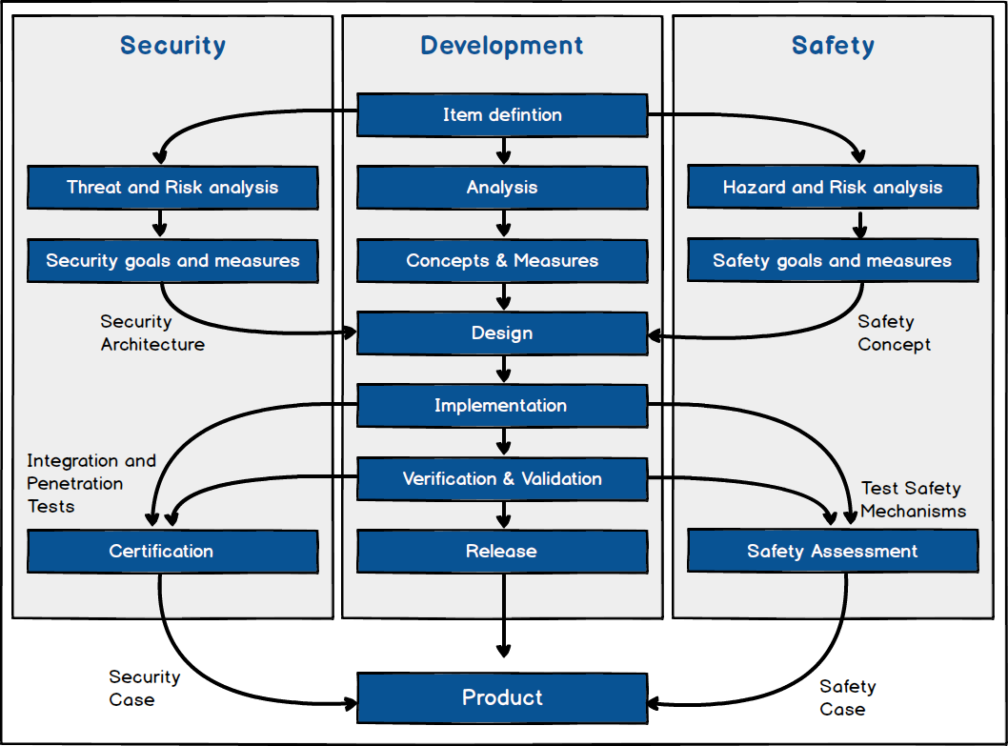
Safety and Security Features
Sprinkler System, Fire Alarm, and Public Address System
Smoke Control
Anti-Ligature and Vandal Resistance
Security-Grade Locks
Electronic Card Key Access
Rated Walls and Security Barriers
Durable Building Materials
Secure Fixtures and Hardware
Secure Furniture and Equipment
Central Nurse/Security stations
Unreachable Recessed Sprinkler Heads
Camera System
Securely Separated Resident Room Sleeping Areas
Monitored Recreation/Exercise Areas
Notes:
The facility will be equipped with a sprinkler system, fire alarm system, and public address system to ensure the safety of the residents and staff.
Smoke control measures will be implemented per codes and regulations. This will be particularly important to enhance safety in the sleeping and holding areas.
All items throughout the facility, including fixtures, furniture, and equipment, will be anti-ligature and vandal-resistant to promote a safe environment. These materials are specifically designed to minimize potential harm to individuals and prevent deliberate damage to the facility. Anti-ligature features remove or reduce the risk of items being used for self-harm or to cause injury while vandal-resistant materials are durable and resistant to damage, reducing the need for frequent repairs or replacements.
Security locks are designed to enhance security and prevent unauthorized access to restricted areas. The use of these locks helps minimize the risk of elopements by ensuring residents cannot easily leave their designated areas without proper authorization.
Exit doors throughout the facility will be controlled by electronic card key access. This system allows for controlled access to the exterior of the building.
The facility will include rated walls and security barriers. These elements are essential for preventing unauthorized access to certain areas, and minimizing the risk of elopements. The rated walls are designed to be highly resistant to break-ins or breaches, while security barriers, such as fences or controlled access points, provide additional layers of protection.
The facility will be constructed using durable building materials to withstand wear and tear, reducing maintenance and repair needs. Materials such as reinforced concrete slaps, metal studs, and TPO roofing membranes are chosen for their strength and longevity.
All doors, windows, and other fixtures will be installed with secure hardware and fittings. This includes heavy-duty locksets, reinforced hinges, and tamper-proof fasteners.
Furniture and equipment throughout the facility will be designed to prevent easy lifting and throwing.
Central nurse/security stations strategically located to provide complete line-of-sight down all bedrooms and staff offices/treatment areas hallways.
High ceilings will be implemented, ensuring sprinkler heads are recessed and out of reach. This design feature prevents damage to equipment and self-harm to residents.
A comprehensive camera system will be installed to monitor common spaces throughout the facility. The cameras will record activities, and aid in reviewing adverse events, investigating incidents, and addressing allegations of misconduct. The cameras will have a 30-day recording period.
Resident room sleeping areas are designed to be securely separated. This design ensures the privacy, safety, and dignity of all residents while meeting their specific needs.
The recreational/exercise areas within the facility will have no blind spots and can be monitored from both inside and outside. This feature enables staff to supervise activities effectively, ensuring the safety and security of residents during recreational and exercise periods.

Slide 21
Reception and Administration Area
Upon entering the facility, there will be a reception area where visitors and staff can check-in. It will include a reception desk, seating for visitors, and administrative offices for staff members.
Sample Lobby

Slide 22
Residential Units
The facility will have multiple residential units. All bedroom and sleeping room doors, as well as unit exit doors, will have security-grade locks for safety and privacy. Rated walls and security barriers will be implemented to enhance security.

Slide 23
Common Areas
Sample Dining Area Space
The dining area in the new facility was designed to serve the youth and staff. It will primarily function as a warming kitchen but is sized to accommodate additional equipment necessary to convert it into a full-sized kitchen in the future.
The facility will have various common areas for the residents and staff. These areas will include dining areas, recreational spaces, and shared living spaces.
Sample Classroom
Sample Common Area

Slide 24
Floor Plan

Slide 25
Enlarged Floor Plan
Lobby, Reception, Large Treatment Areas

Slide 26
Enlarged Floor Plan
Administration Area & Treatment/Multi-Purpose

Slide 27
Enlarged Floor Plan
Intake & Security Areas

Slide 28
Enlarged Floor Plan
Nursing, Dental, Barber, Dining Areas

Slide 29
Enlarged Floor Plan
Mechanical, Electrical, Plumbing, & Kitchen Areas

Slide 30
Enlarged Floor Plan
Educational Areas & Gymnasium

Slide 31
Enlarged Floor Plan
Lounge/ Recreational Area

Slide 32
Enlarged Floor Plan
Two Outdoor Activity Courtyards

Slide 33
Enlarged Floor Plan
Typical Bedroom and ADA Bedroom Layout
Notes:
Four of the 24 bedrooms is designed to accommodate ADA residents.

Slide 34
Enlarged Floor Plan
Youth Housing Area: Lounge Areas, Laundry, Group Room, Support Staff Areas, & Nurse Stations

Slide 35

Project Timeline & Milestones
MOU July 1, 2022
PIP JBRC Approval August 23, 2022
PIP SFAA Approval December 1, 2023
Request for Proposal (RFP) August 23, 2023
DBOM Contract Agreement December 6, 2023
Preconstruction
  SE-580 Building Permit December 4, 2023
  Schematic Design February 5, 2024
  Design Development May 8, 2024
  Early Release CD June 24, 2024
  Construction Documents Review July 24, 2024 – Sep. 6, 2024
Construction Sep. 16, 2024 – Oct. 16, 2025
Anticipated Mobilization Mid – August 2024
Operations Jan. 6, 2025 – Dec. 7, 2025

Slide 36

Budget Breakdown
22,939,405.00 | Established A1 Budget
9,918.25 | Dennis Corporation - Existing Condition Survey
12,750.00 | S&ME - Geotechnical Exploration Services
377,169.36 | LCK – Project Management Services
72,000.00 | SSOE Group - Independent Peer Reviewer Services
21,776,535.00 | CC of SC - DBOM
3,946.33 | DBOM Change Order #1
118,550.00 | DBOM Change Order #2
7,486.00 | DBOM Change Order #3
240.00 | DHEC
93,682.00 | S&ME - 3rd Party Inspections
55,600.00 | System WorCx - Commissioning
411,528.06 | Remaining Balance
The project has an established A1 Phase II with an approved budget of $22,939,405.00 Currently, the project has a remaining balance of $411,528.06 of unobligated funds (contingency for unforeseen issues outside the development agreement).

Slide 37
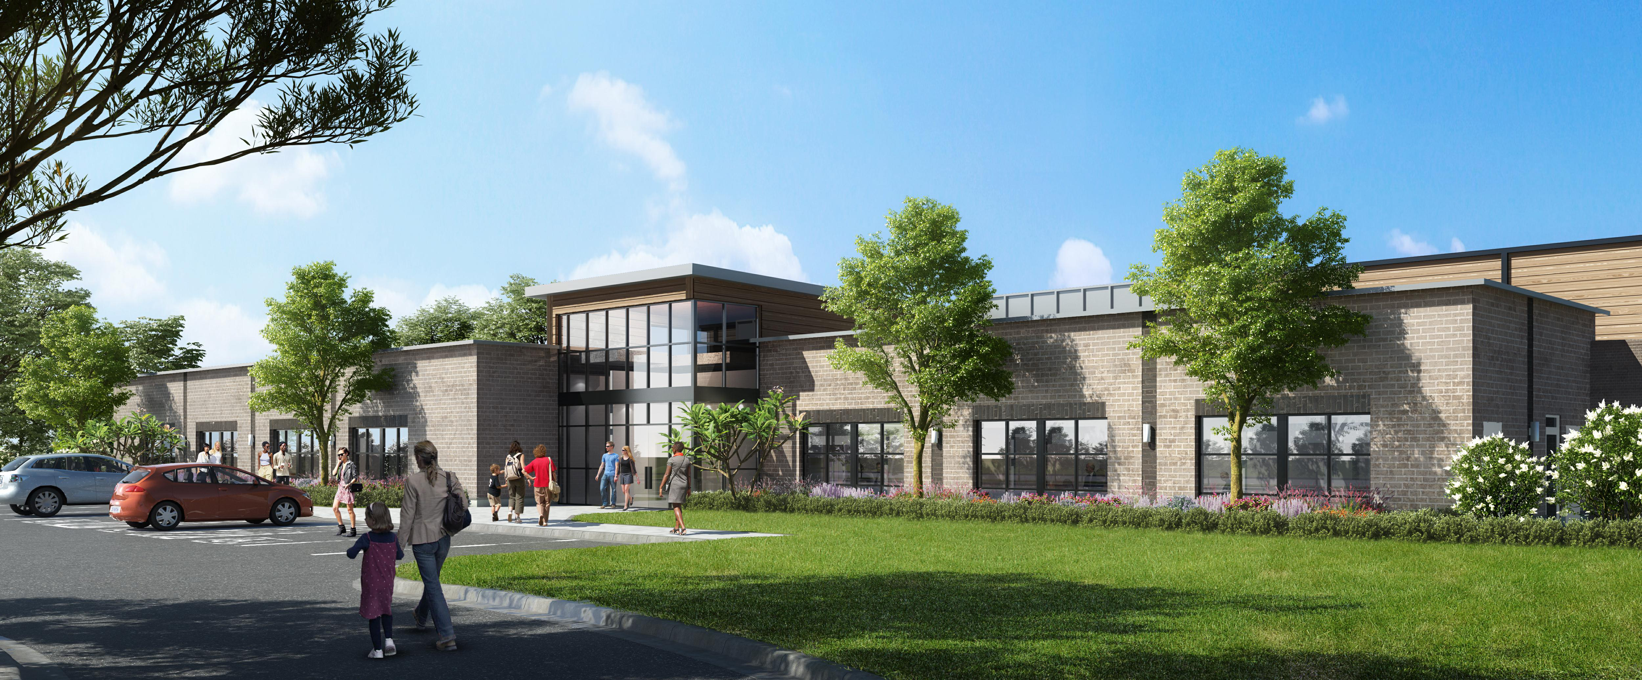
Conceptual Design

